Slide 1
How to Download and Install RStudio
Course: STAT318-462-23S1 (Data Mining)
Tutor: Kathy, Meng

Slide 2
Contents
1. What is RStudio
2. Downloading and installing R
3. Downloading and installing RStudio
4. RStudio interface

Slide 3
What is RStudio?
RStudio is a powerful integrated development environment (IDE) for the R programming language. It has many useful features that make coding in R more efficient.

Slide 4
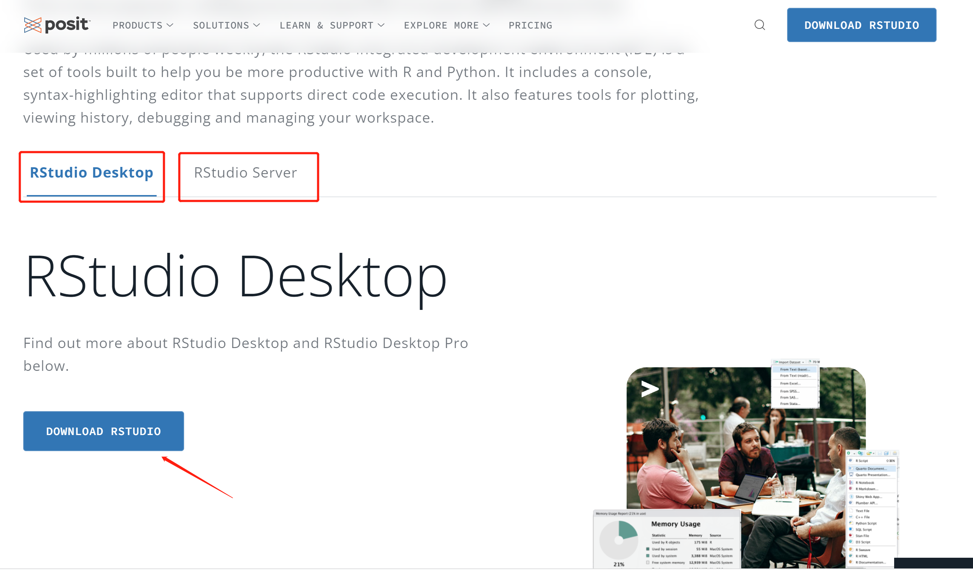
Downloading R
From: https://posit.co/downloads/

Slide 5
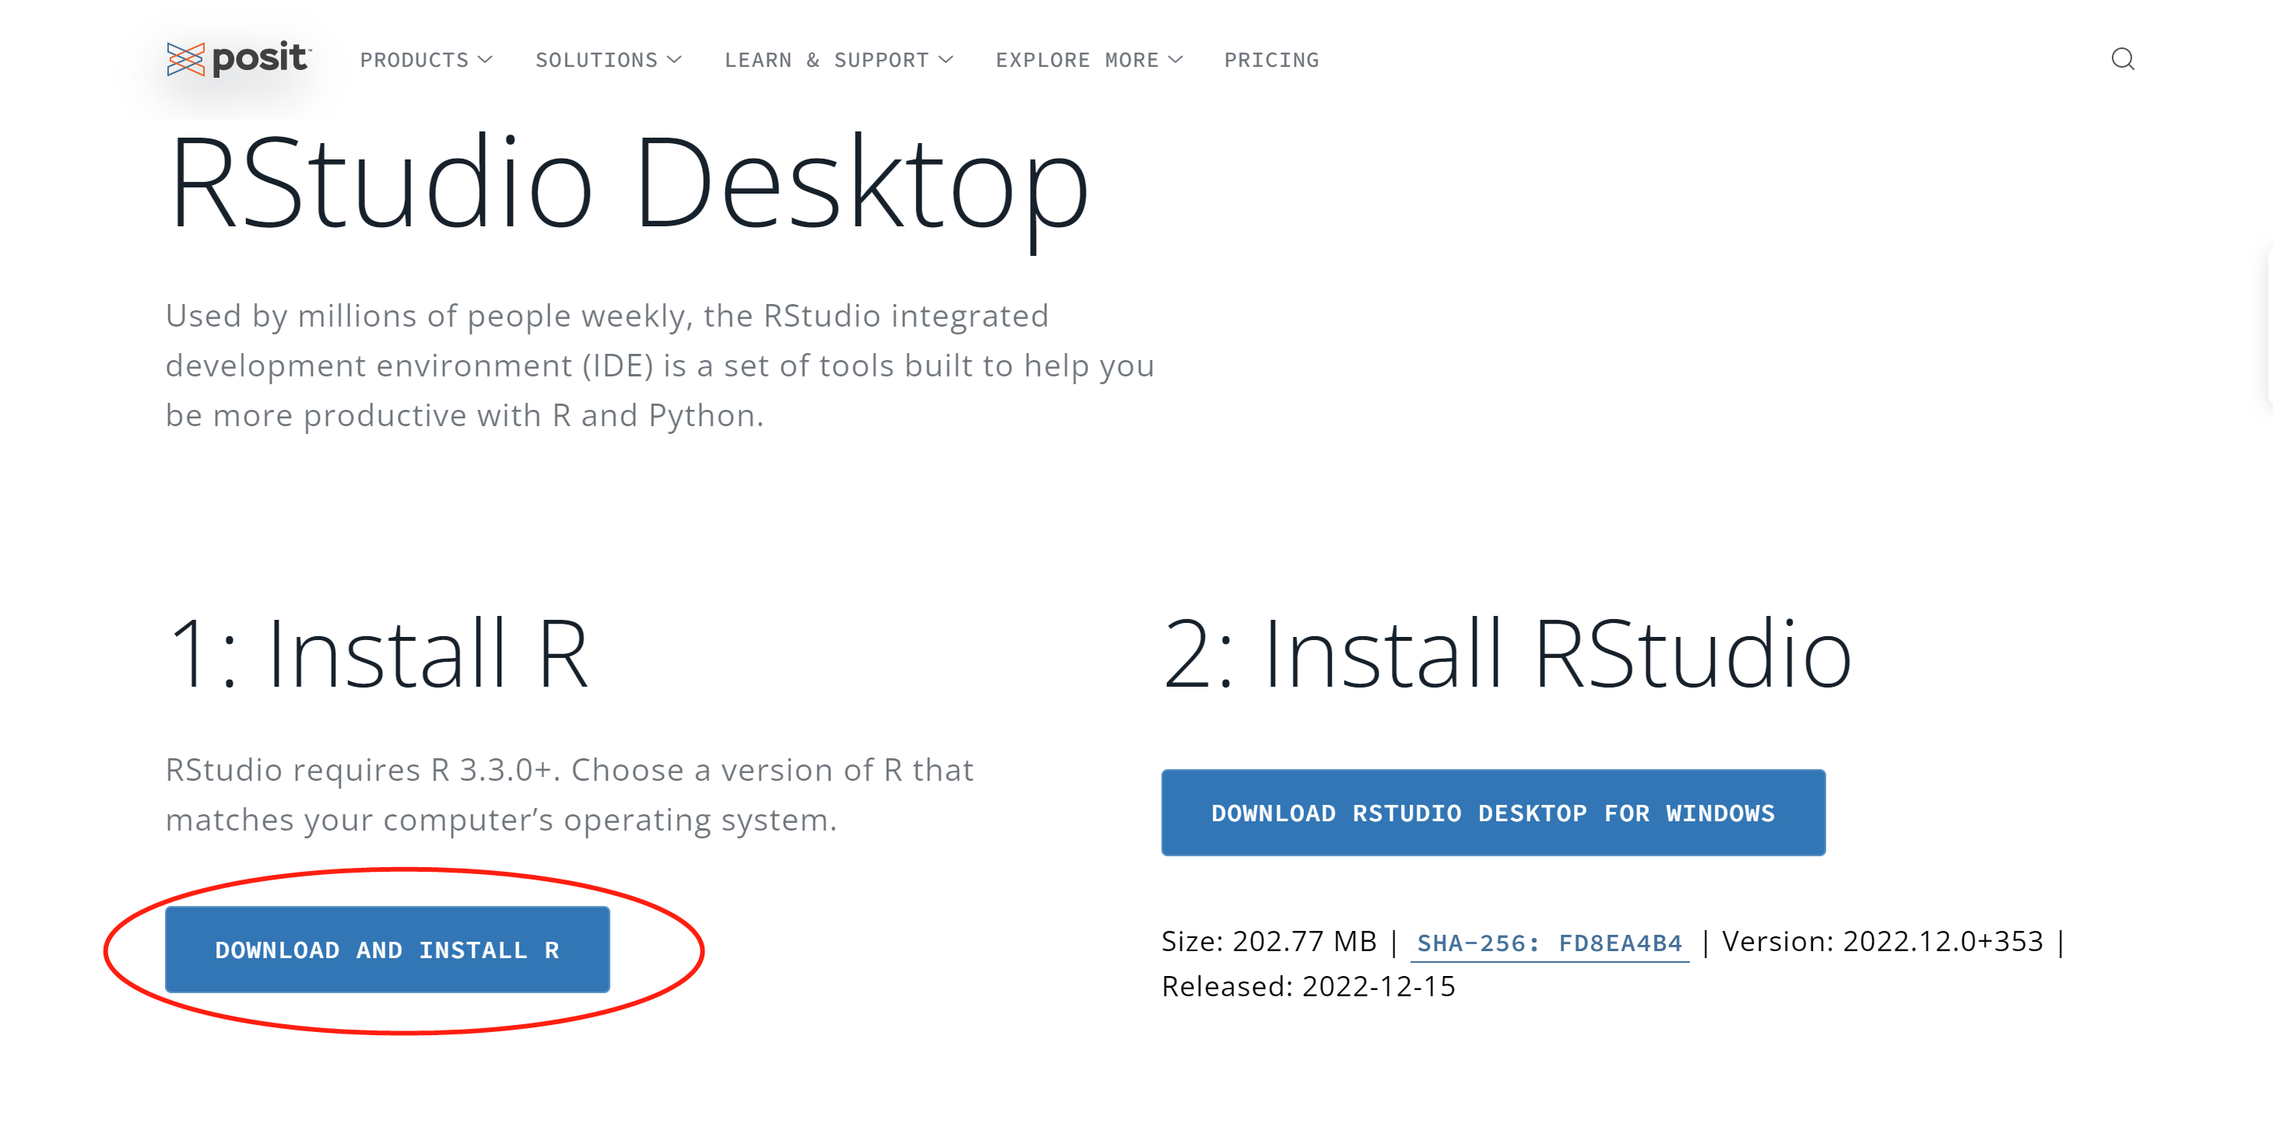
Downloading R
From: https://posit.co/download/rstudio-desktop/

Slide 6
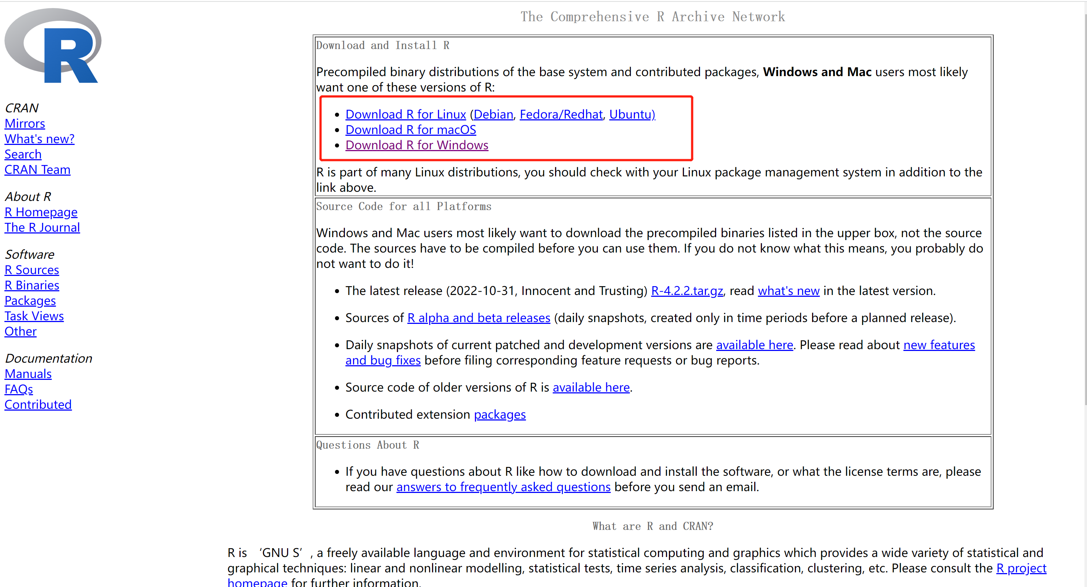
Downloading R
From: https://cran.rstudio.com/

Slide 7
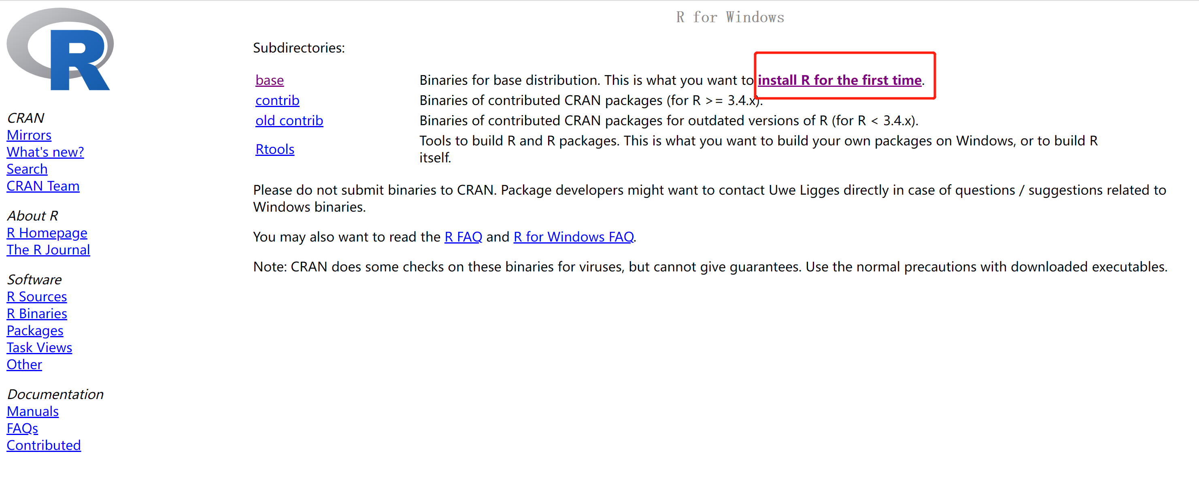
Downloading R
From: https://cran.rstudio.com/

Slide 8
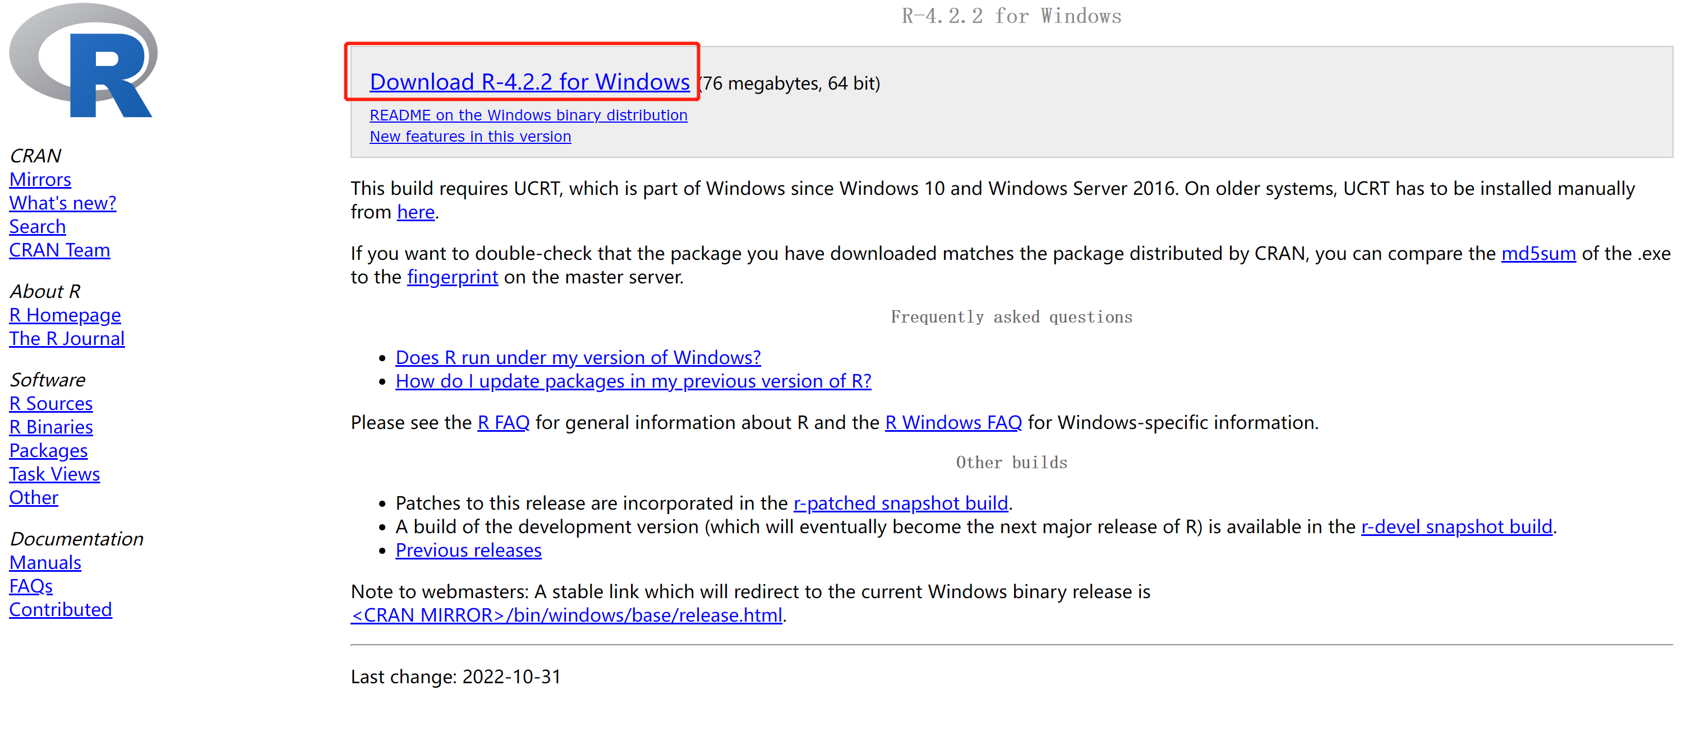
Downloading R
From: https://cran.rstudio.com/

Slide 9
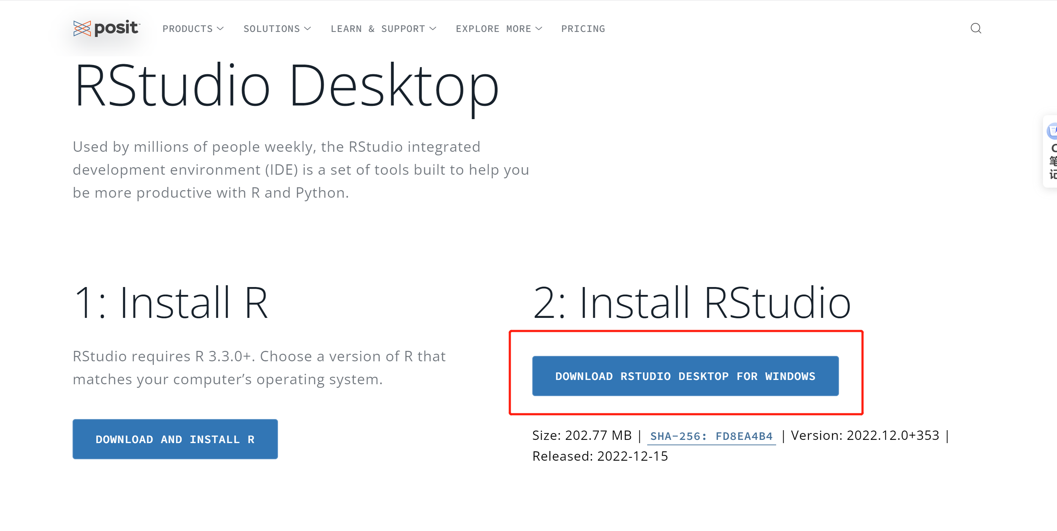
Downloading R studio
From: https://posit.co/download/rstudio-desktop/

Slide 10
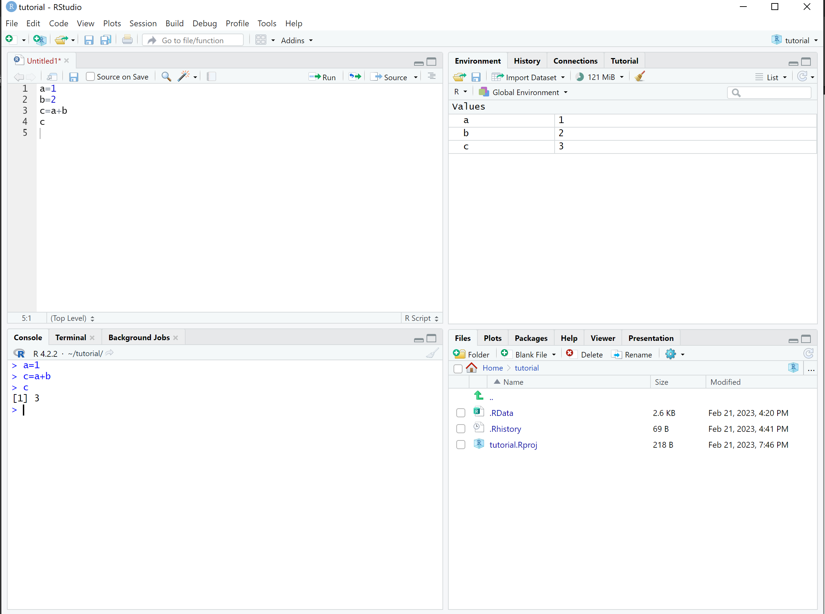
RStudio Interface
Source Editor
Workspace
Console
File

Slide 11
Thanks
Course: STAT318-462-23S1 (Data Mining)
Tutor: Kathy, Meng

